Slide 1
Women Safety Awareness for Teenagers
Anand Samayam (U1401882) Fnu Pankhuri (U1430792) Maneesh Reddy Nalla (U1406602)

Slide 2
Importance of Women’s Safety
Empowerment: Women's safety awareness equips teenagers, both girls and boys, with knowledge and skills to protect themselves and others from violence, harassment, and discrimination. It empowers them to assert their rights, set boundaries, and make informed decisions to ensure their own safety and well-being.
Prevention of violence: Women's safety awareness educates teenagers about the warning signs of violence, such as abusive relationships, sexual assault, and stalking, and helps them recognize and respond to such situations. It promotes healthy relationships based on respect, equality, and consent, and encourages teenagers to speak up and seek help if they or someone they know are at risk of violence.
Respect for diversity: Women's safety awareness promotes an understanding of gender equality and challenges harmful gender norms and stereotypes. It encourages teenagers to respect and value the diversity of gender identities and expressions, and promotes inclusivity and acceptance of all individuals, regardless of their gender.

Slide 3
Importance of Women’s Safety
Building safe communities: Women's safety awareness fosters a culture of safety and respect in communities, including schools, neighborhoods, and online spaces. It encourages teenagers to be active bystanders and intervene when they witness harassment or violence, and to promote safe and inclusive environments where everyone can thrive.
Breaking the cycle of violence: Women's safety awareness helps teenagers recognize the impact of violence on individuals, families, and communities, and promotes non-violent ways of resolving conflicts. It encourages teenagers to break the cycle of violence by fostering healthy relationships and addressing harmful attitudes and behaviors towards women and girls.
Promoting gender equality: Women's safety awareness highlights the importance of gender equality and challenges gender-based discrimination and bias. It encourages teenagers to be advocates for gender equality and to challenge harmful gender norms and stereotypes that perpetuate violence and discrimination against women.

Slide 4
Data Collection and Labelling:
We collected data using the google teachable machine’s web camera; clicked real time photos and incorporated those to train the final model.
We labelled the classes on the basis of user’s actions and segregated them into 8 different categories. The amount of photos taken in each class varied from 50-147 depending of the action performed by the user.

Slide 5
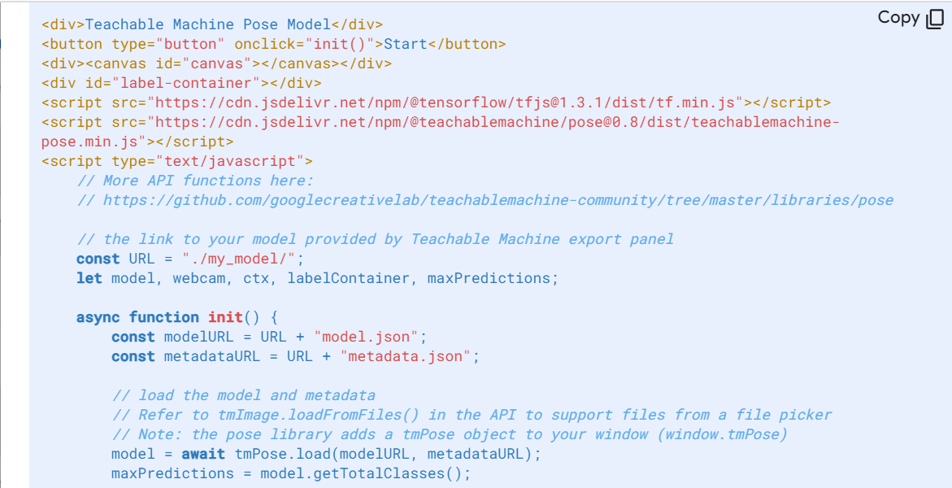
Code Snippet:

Slide 6
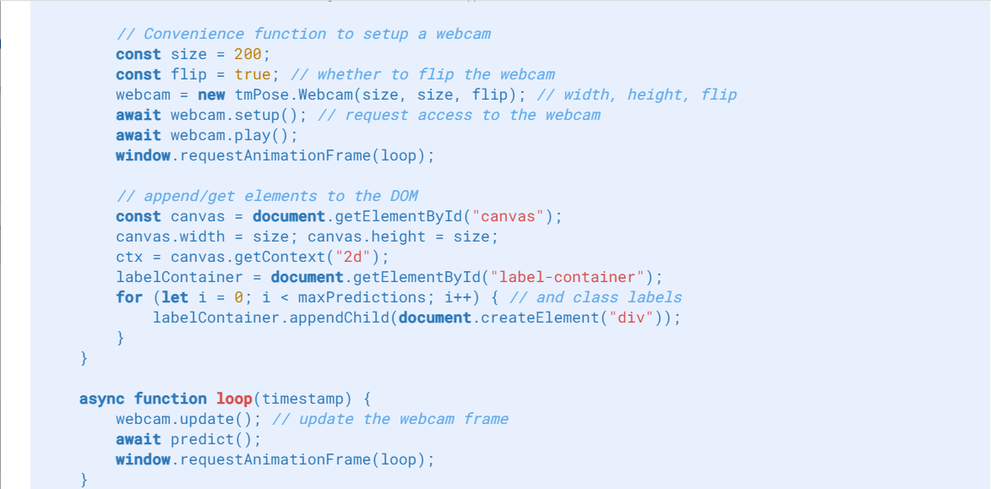
Code Snippet:

Slide 7
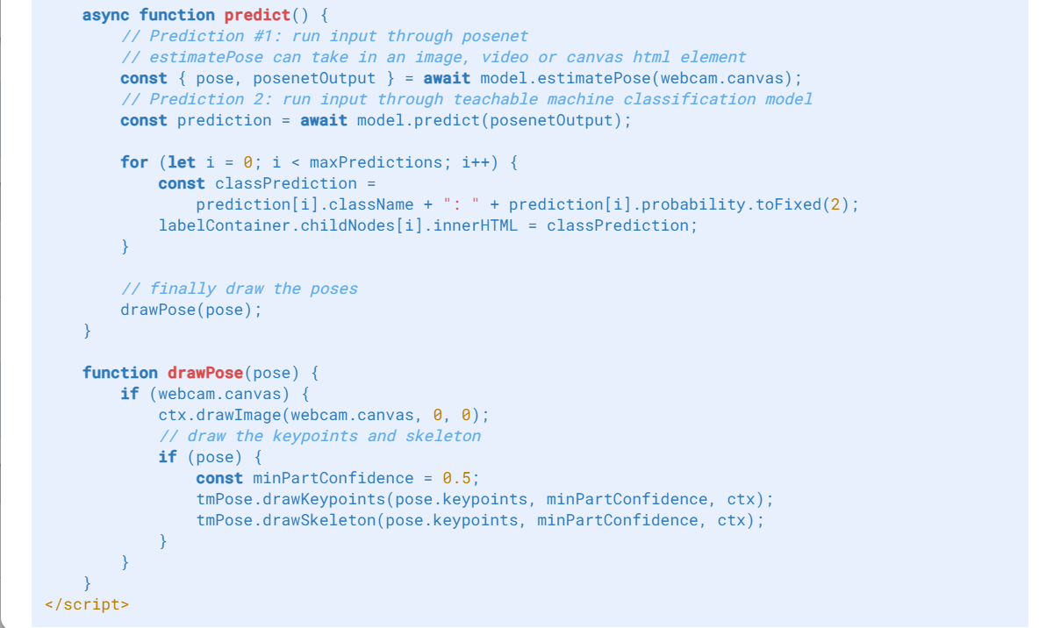
Code Snippet:

Slide 8
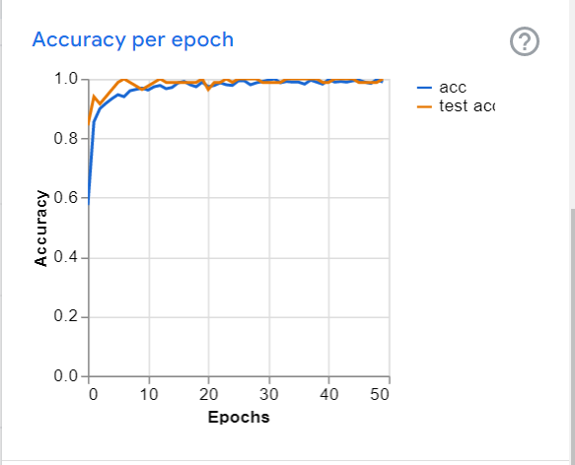
Accuracy Result of the machine learning model:
Accuracy = 1

Slide 9
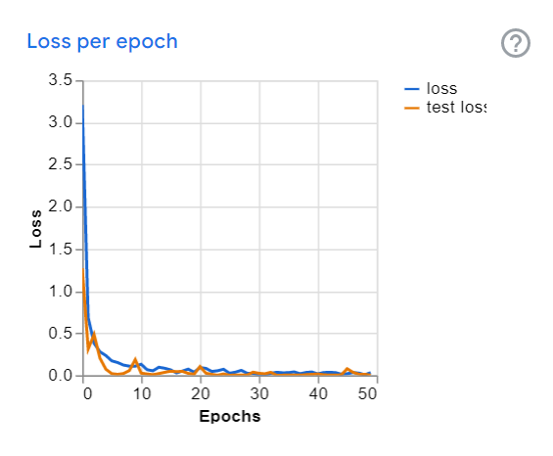
Epochs Result of the machine learning model:
Batch Size = 16 Epochs = 50

Slide 10
Challenges faced during the training process:
Time Complexity: The model was slow to recognize certain actions of the user. We can overcome this by taking pictures of better quality along with a well lit background.
Body Orientation: Proximity of the user from the camera plays an important role, therefore the user must be situated not too far or close from the camera.
Model Parameters: On increasing the epochs size and decreasing the learning rate the mode doesn’t perform well. Sample size must be configured correctly to obtain competent accuracy.

Slide 11
Conclusion:
Women's safety awareness is essential for teenagers as it empowers them with knowledge, skills, and attitudes that promote safety, respect, and equality.
It plays a crucial role in preventing violence, fostering healthy relationships, promoting gender equality, and building safe communities where everyone can thrive.
Ensuring women's safety is not only a moral imperative but also a fundamental human right. By prioritizing women's safety and taking concrete actions to address the root causes of gender-based violence and harassment, we can create a world where women can live freely, without fear, and fulfill their potential.
It is time to come together as a society and take decisive action towards achieving gender equality and making the world a safer place for all women.

